Slide 1
Scribblers on the Roof
Project 3
Michael Chopade, Christine Mitchell, Addisalem Tamiru, and Erin Ford

Slide 2
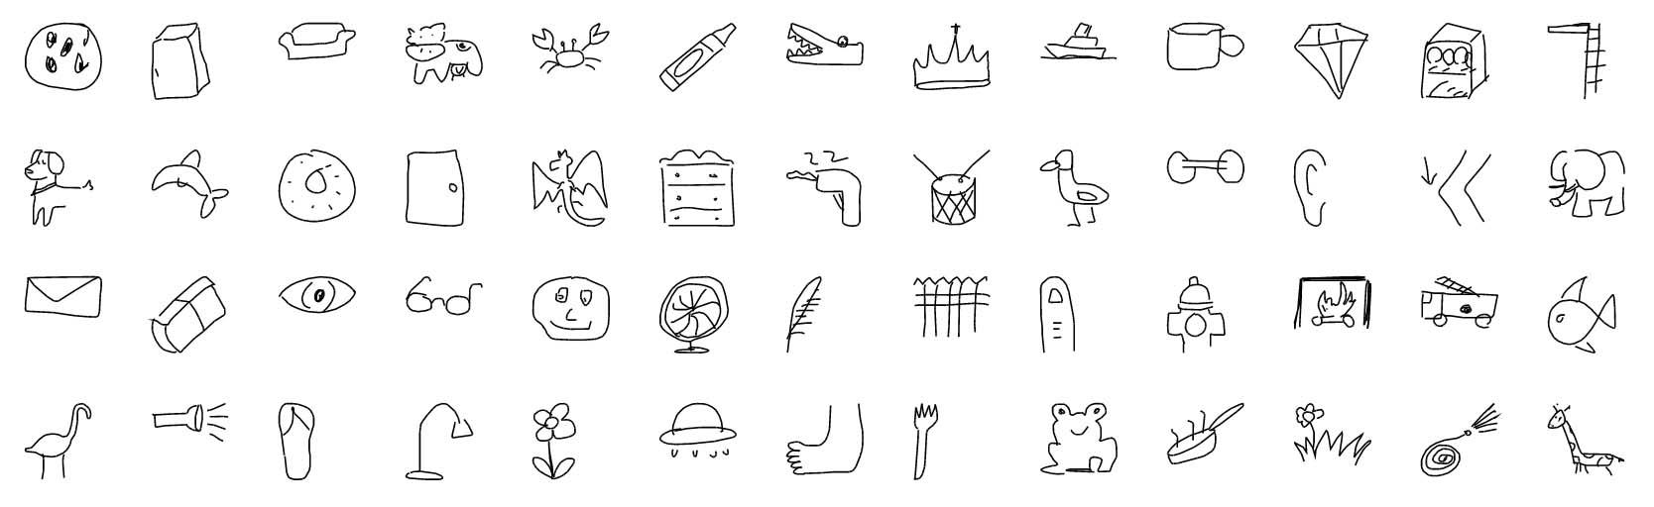
Objective:
Using the “Quick Draw” dataset from Google, our team will attempt to train a CNN to recognize 14 different doodled “subjects”. We will then create an interactive webpage where a user can “doodle” and our AI will attempt to guess what they drew.

Slide 3
Data:
https://www.kaggle.com/google/tinyquickdraw
https://github.com/googlecreativelab/quickdraw-dataset
Our data comes from Google Labs “Quick, Draw!” AI experiment. The game asks a user to draw a doodle, then the games AI tries to guess what it is! Google compiled 50 million drawings submitted through the game and released them for ML use. The original data collected included country of origin, timestamps and a JSON Array representing the final drawings. That dataset was HUGE! We dug a little bit further and found a preprocessed dataset that simplified the drawings into 28 x 28 greyscale bitmap images.

Slide 4
Coding Approach
-Design and train model in Jupyter Notebook
-Create Flask to Accept Images
-Design interactive site to predict the picture that the user drew in the scribble pad.

Slide 5
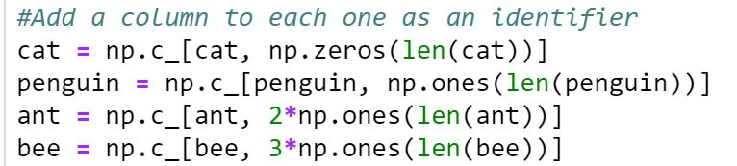
Training the Model
-Select 14 different drawing classifications, download large files from Google, and upload them to Jupyter notebook.
-Add extra column as an identifier:
-Concatenate lists to create our X and y variables
-Train/Test/Split data

Slide 6
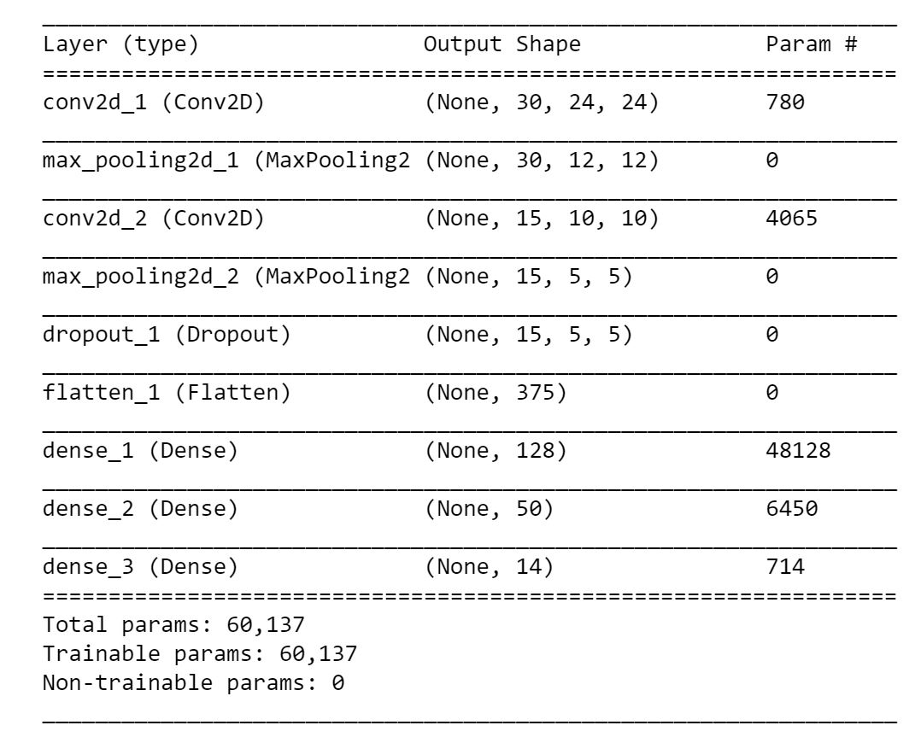
Compiling the Model
Using an example from github user ck090 -
After training with a batch size of 10 and using 30 epochs for training both the training and validation set of images. The image sizes are 28x28 (std. MNIST dataset sizes). We trained/tested 50/50
The CNN is a 9-layer CNN which is composed of:
A convolution layer of size 5x5
A Max pooling layer of size 2x2
A smaller convolution layer with size 3x3
A Max pooling layer of size 2x2
Dropout layer with a probability of 20%
Flatten layer
Fully connected layer with 128 neurons and rectifier activation.
Fully connected layer with 50 neurons and rectifier activation.
Output layer. Keras requires one hot encoding of the y labels

Slide 7
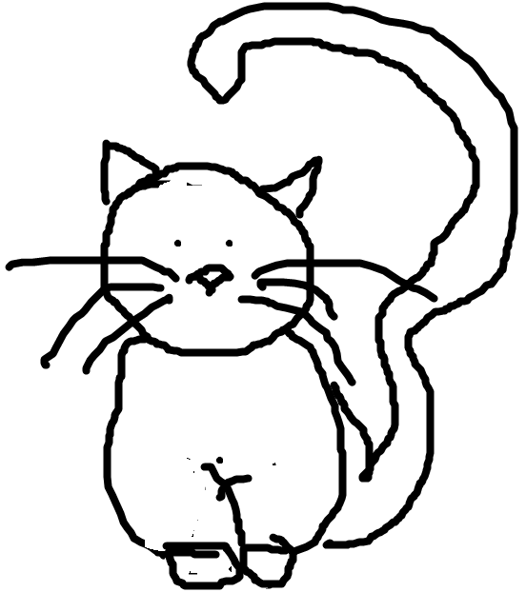
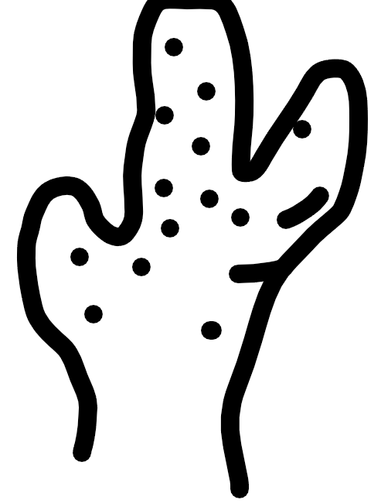

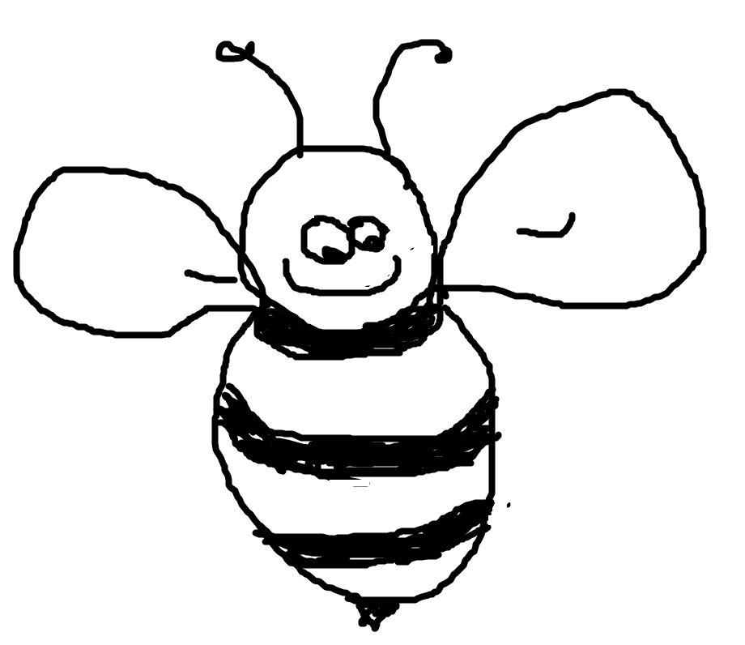
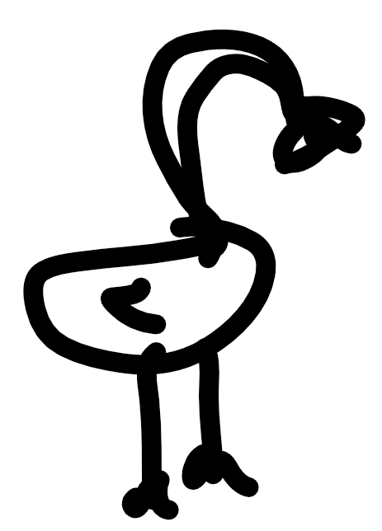
Accuracy
After running the training model, (2 hours to run due to our large input size), we achieved 89.4% accuracy with 0.35 loss.
After obtaining a working model, we tested it by predicting images that were drawn in paint. We found that images with heavy lines and minimal white space were more accurately predicted.

Slide 8
Flask App - Digitizing and Predicting
Preload keras model into app - quickdraw.h5 framework
Source images converted and arranged into arrays
Similar to NIST/MNIST datasets
App saves drawn image, converts, and runs through models framework
Model creates prediction, returning a number corresponding to index of preloaded images and jsonifies the data

Slide 9
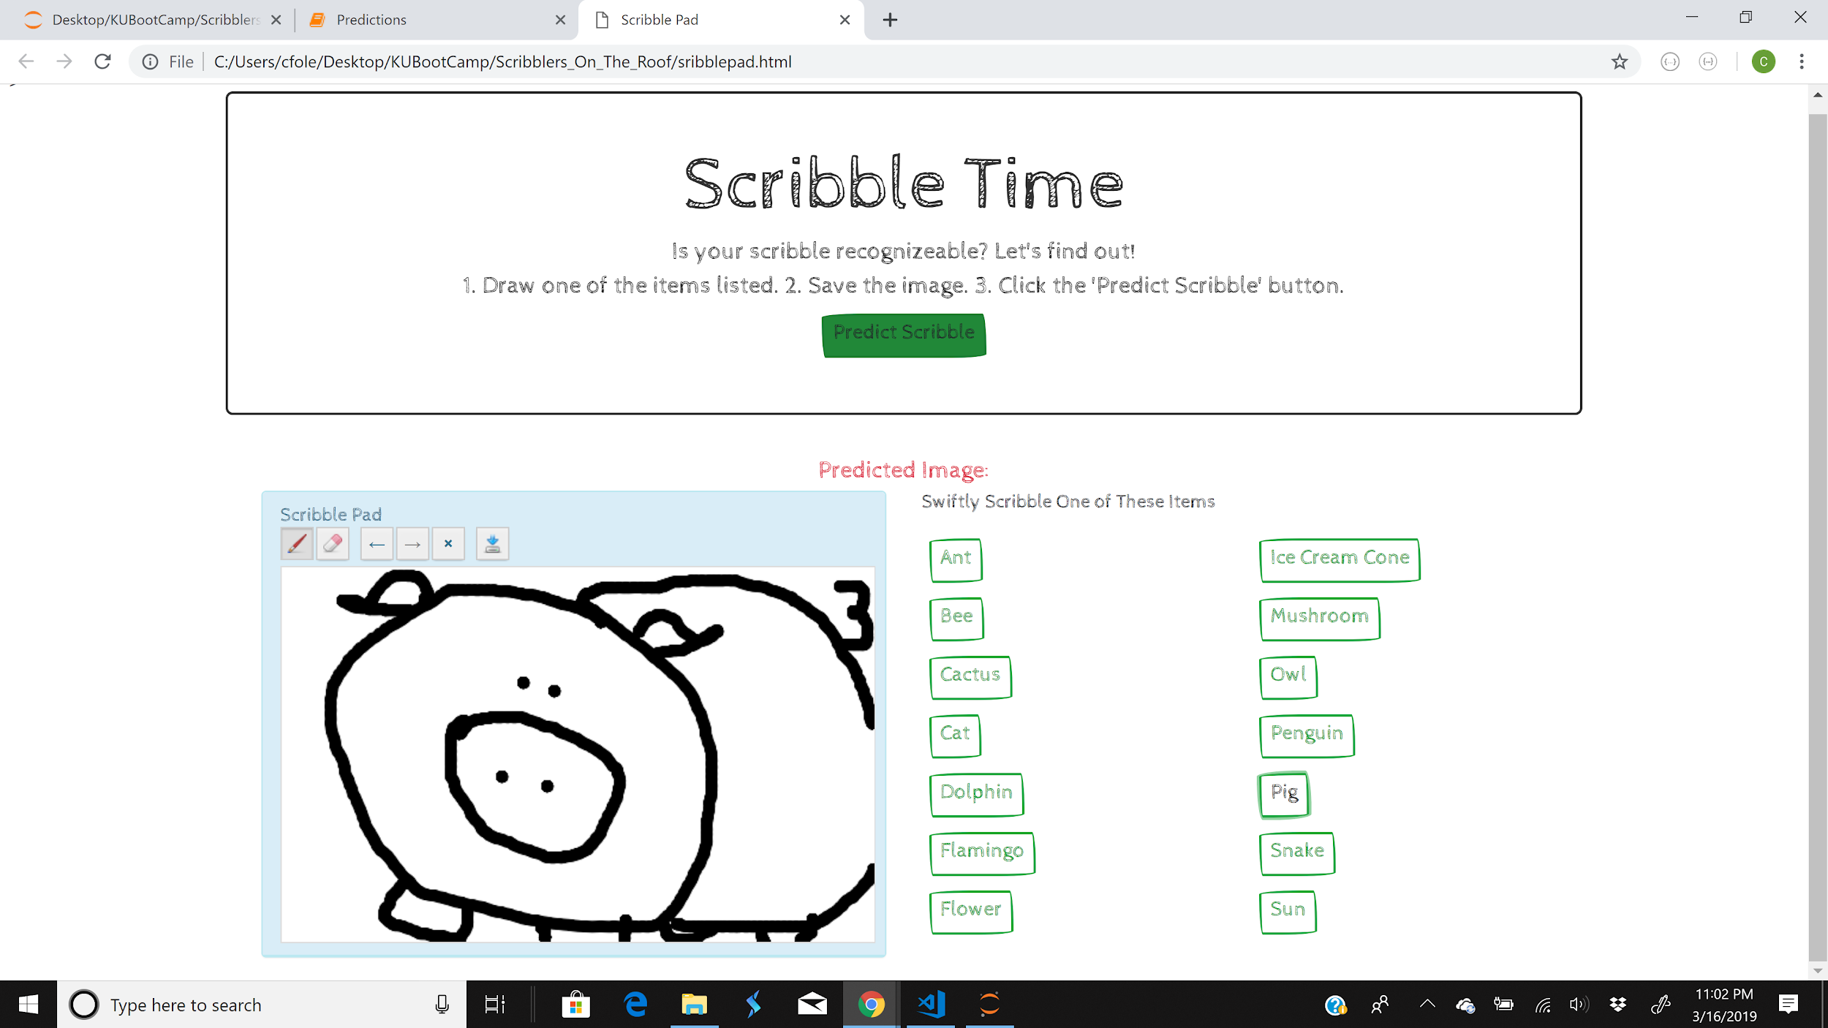
A Little Sketchy
Incorporating the sketchy theme from bootswatch, we were able to design an aesthetic site.

Slide 10
Scribble Time!
Our goal was to make a fun HTML page in which the interaction was as easy as 1, 2, 3.
1. The user would select an item from our list to draw,
2. they would draw that image in the scribble pad, then
3. push the predict button to see if the computer model would recognize their doodle.

Slide 11
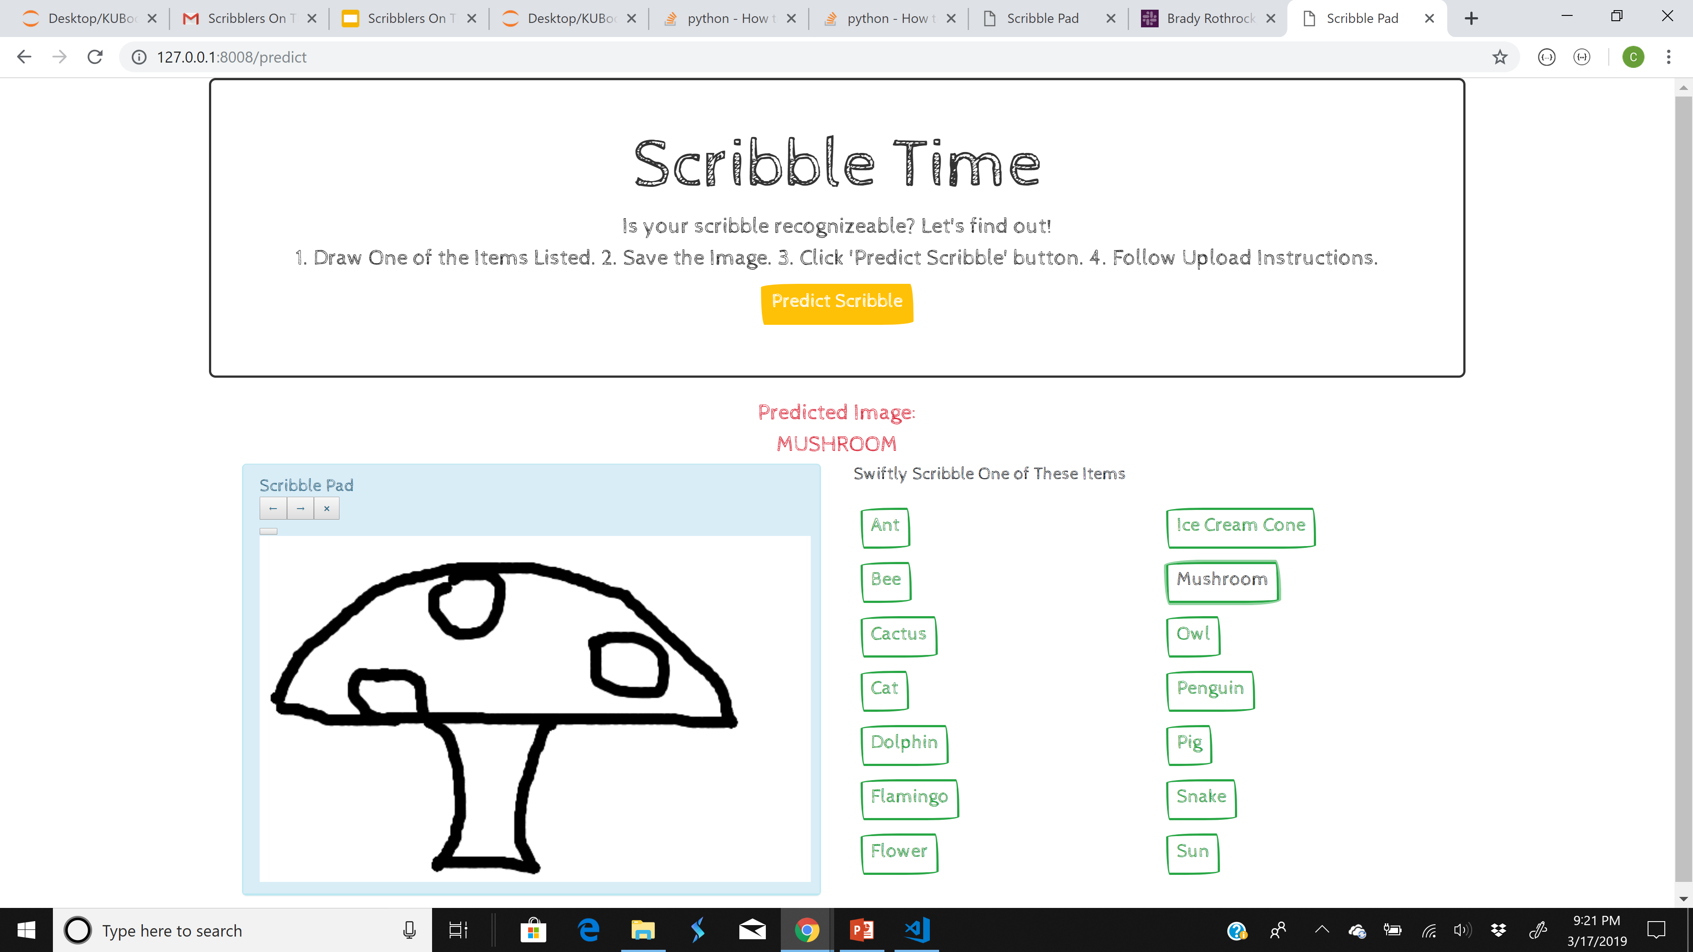
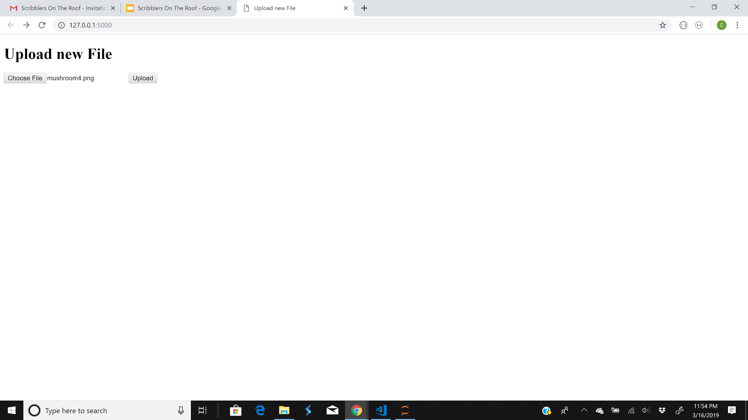
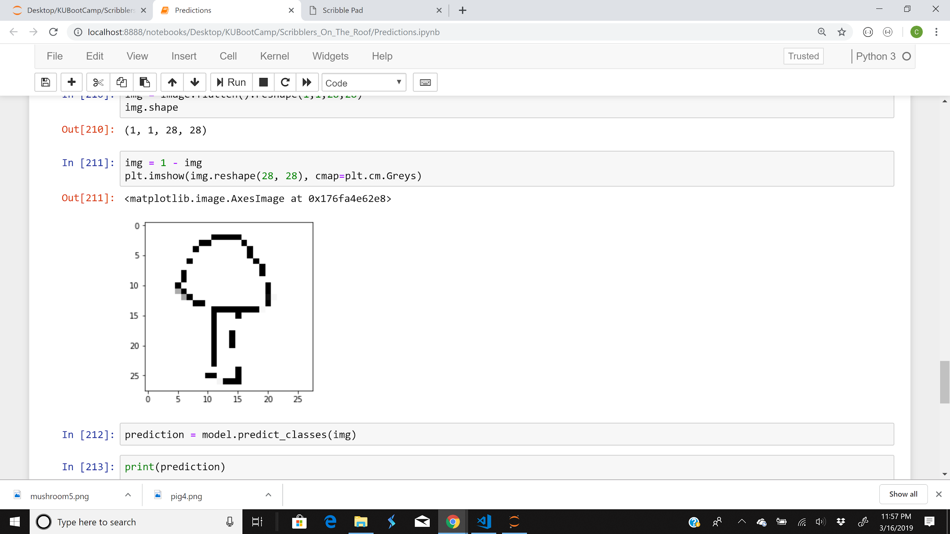
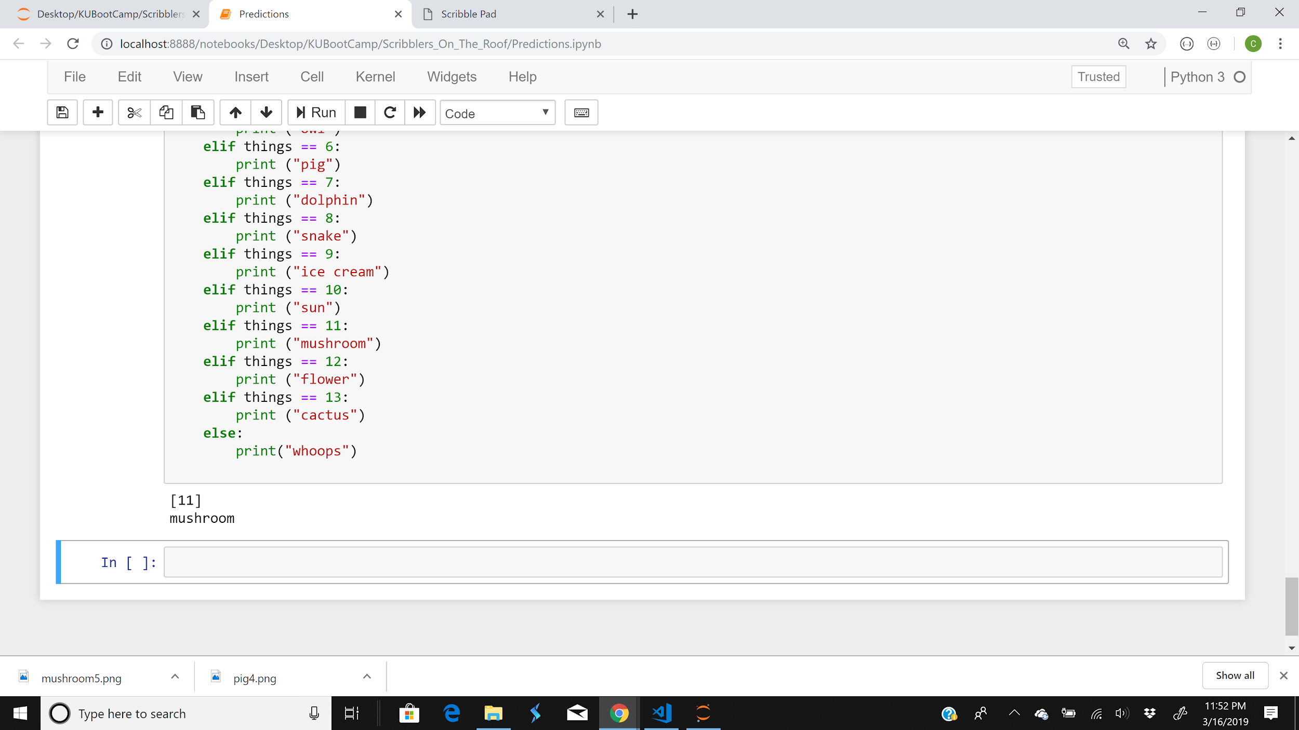
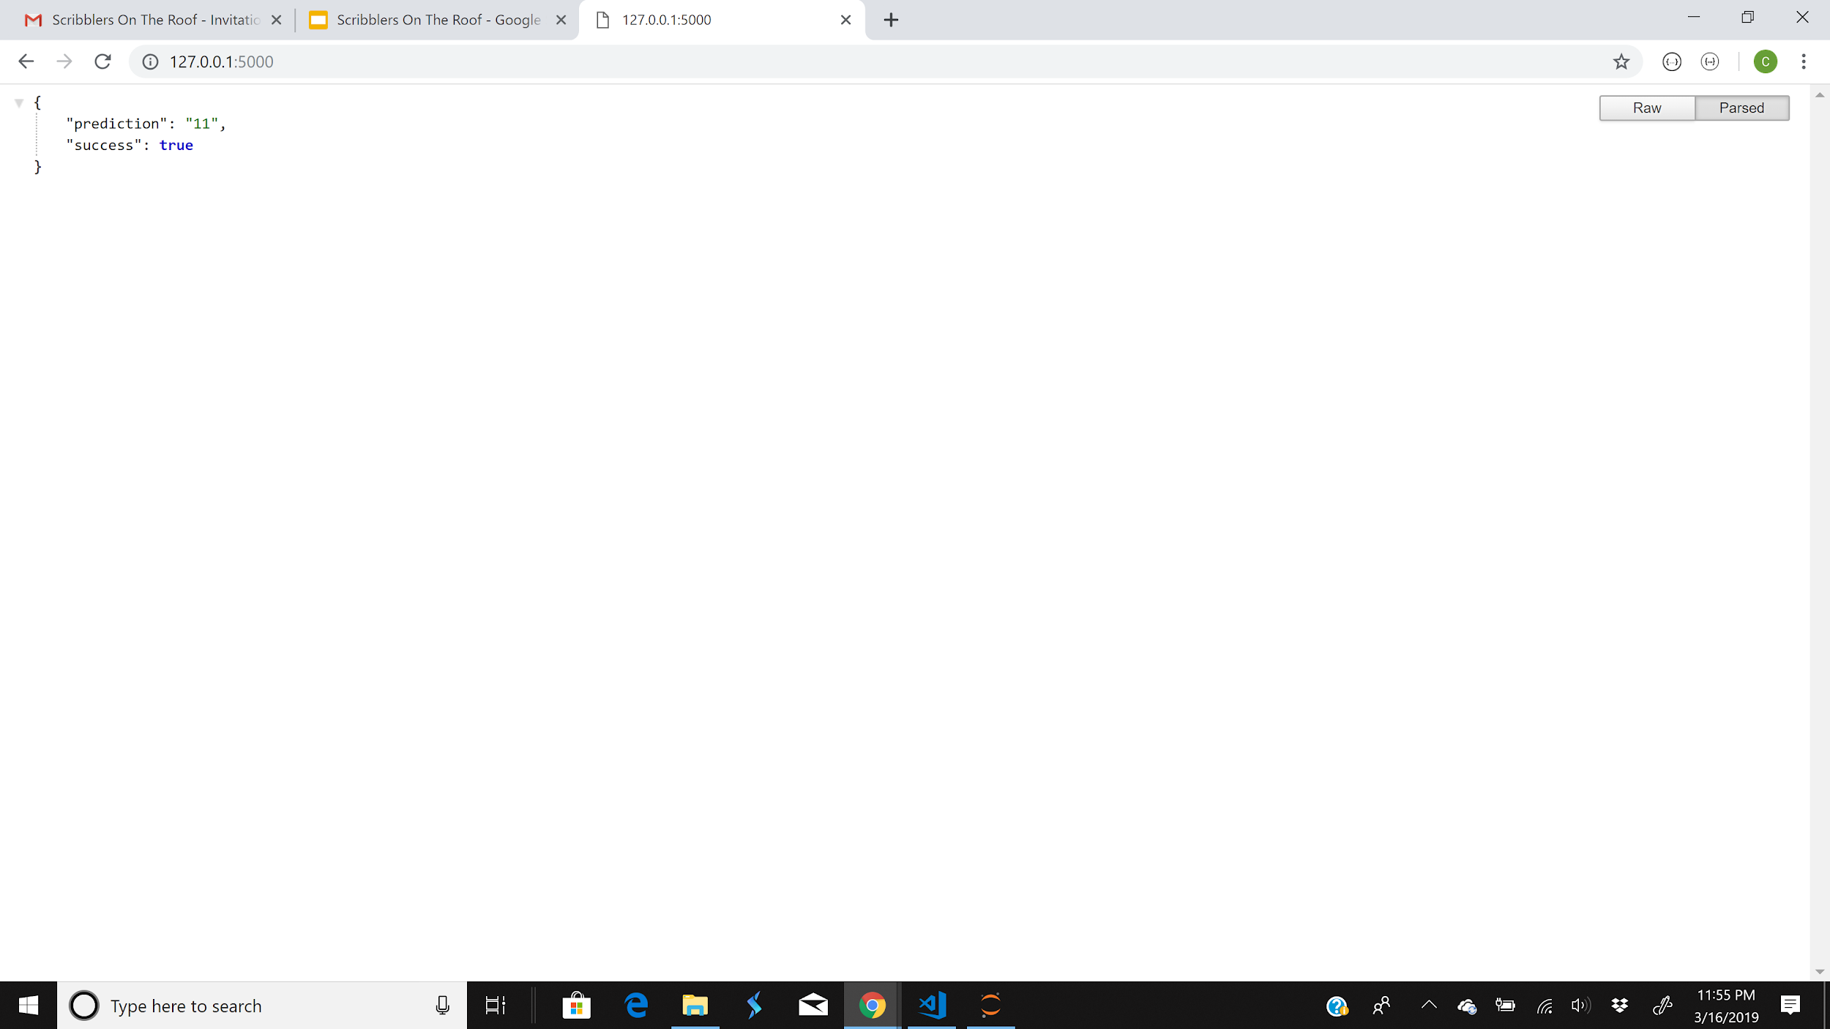
Behind the Sketch - Piecing it together

Slide 12
Behind the Sketch
The HTML code was fairly simple, however the trick was utilizing the following libraries to insert a functioning HTML canvas:
jquery
drawingboard.js library (modified the code to customize our scribble pad)
Ideally the FLASK would have allowed us to save the image, then return the prediction in one click of the button. However, due to challenges we had to keep these functions separate.

Slide 13
Demonstration
Single Scribble Demonstration
https://youtu.be/pFRYrKUPPnQ
Multiple Scribbles Demonstration
https://youtu.be/03-BzOdNZQU

Slide 14
Key Learnings/Challenges
-Google had minimal documentation on how to use the data.
-Giant datasets for individual drawing “collections”-- unable to load them onto Github
-We have to ensure that we are using the same version of KERAS as what the model was built in.
-Images need a thick font and minimize white space for better predictions.

